Slide 1
UniChat
Louis
Brett
Johnny
Winco

Slide 2
What is it?
Social media platform for students
Eliminates the need for multiple social networking apps
Similar to other social media platforms

Slide 3
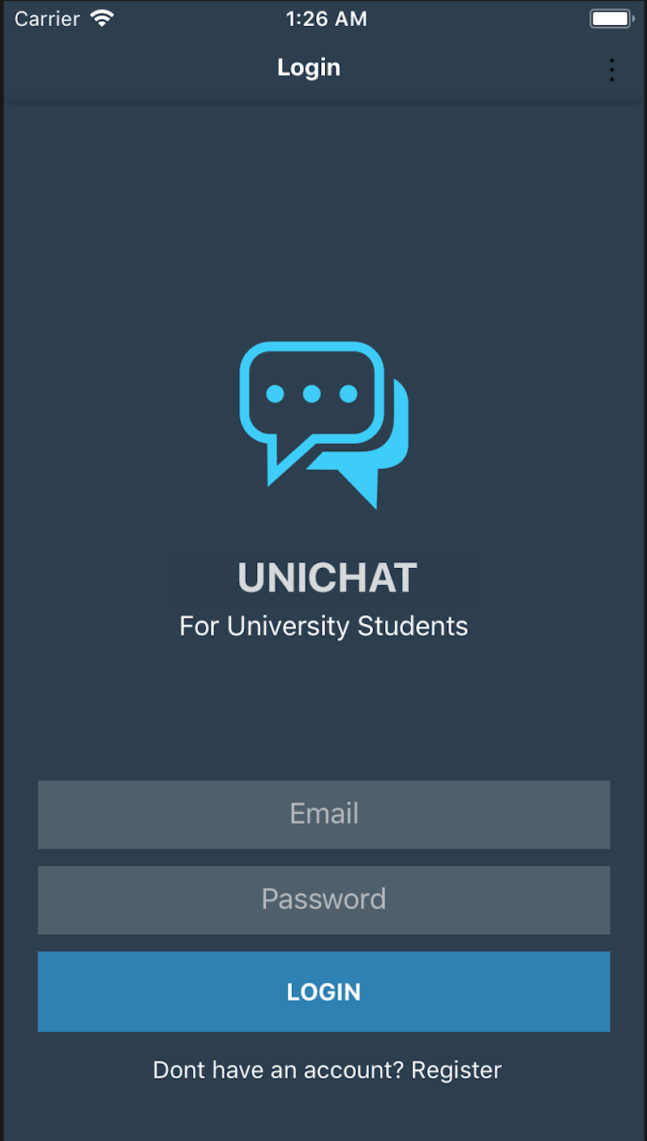
Accounts
Locked to university students
Easily find other friends
Custom nicknames and profiles

Slide 4
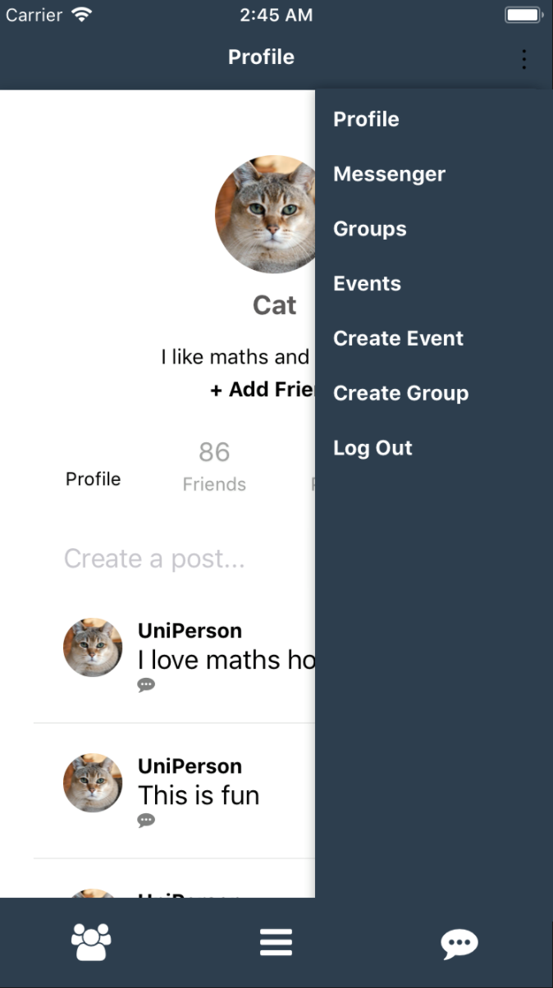
User Experience
Easy to use
Simplistic
No ads

Slide 5
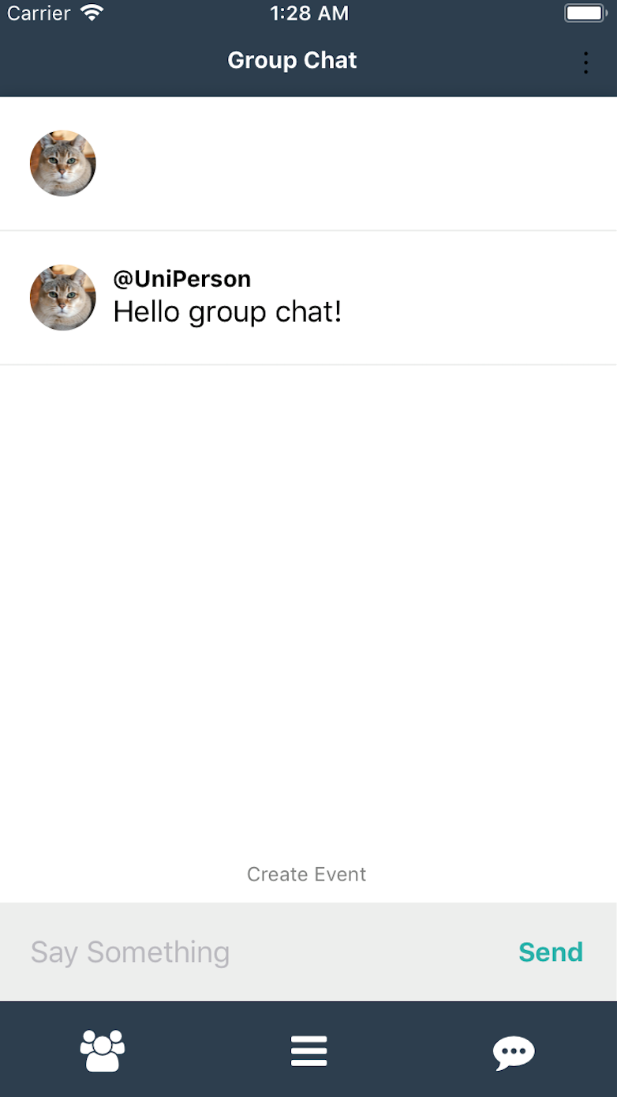
Chat
Friends
Societies
Group assessments

Slide 6
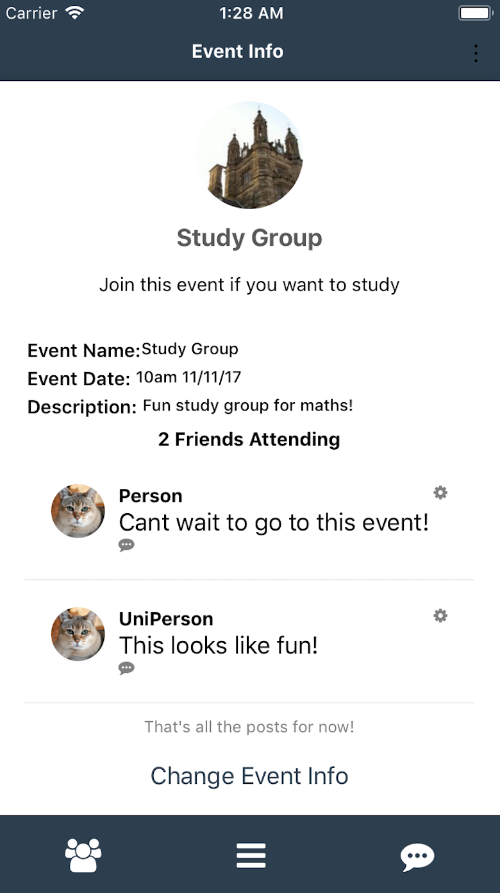
Events
Host
Share interests
Meet new people

Slide 7
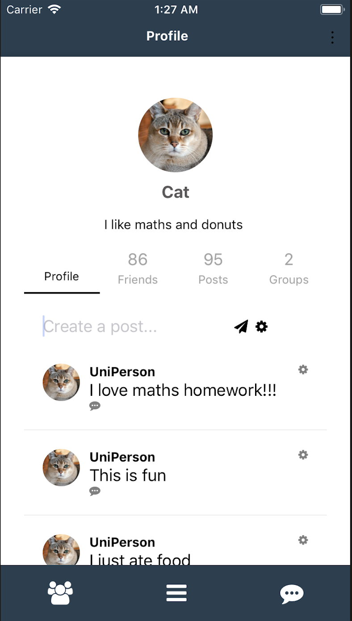
Profiles
Share
Experiences
Stories
Comment
Change who sees your content

Slide 8
Thanks!

